Slide 1

A Smart Patient Monitoring System for Improved Healthcare
Supervisor
MOHAMMAD MAMUN ELAHI
Assistant Professor
DEPT OF CSE,UIU
Course Teacher
A.K.M. Muzahidul Islam Professor
DEPT OF CSE,UIU
GROUP C-1
Group Members
Abdullah Al Mamun ID: 011 161 186
Dill Mahzabina Tabila ID: 011 161 274
Md. Fanir-Al-Mamun ID: 011 161 142
Sanjida Akter Shimu ID: 011 161 195
Khandakar Sharmin Sara ID: 011 161 197
Sifullah Sajib ID: 011 161 185

Slide 2

Content
United International University
Introduction
Project Overview
Problem Statement
Objective
Motivation
Research Framework
Literature Review
Methodology
Proposed System Architecture
Software Requirements
Hardware Requirements
Expected Outcomes
Implementation
Standards and Design Constraints
Gantt Chart
Conclusion and Future Work
References

Slide 3
Introduction
United International University
Project Overview:
Develop a cloud-based Smart Patient Monitoring System using Internet of Things (IoT).
Collect patient data through sensors and monitor through a centralized web-based application.
Pre-process the collected data and decide which data to forward to the cloud for user (doctors/attendants) apps.

Slide 4
Introduction (contd.)
United International University
Objective:
To design a system for collecting a patient's body status at regular intervals through sensors.
To develop an web-based application to monitor critical patient conditions 24/7.
To provide a common platform for efficient interaction between patients and doctors.
Problems in Existing Healthcare System & Motivation:
Shortage of medical personnel.
Hospital system mismanagement.
Inexperienced new medical personnel.
Medical personnel absenteeism.

Slide 5
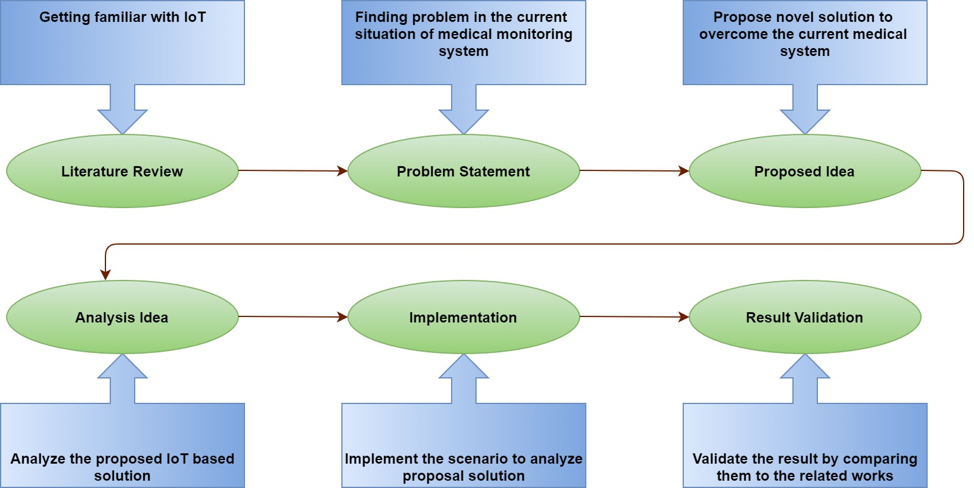
Introduction (contd.)
United International University
Research Framework
Figure 1: Research Framework

Slide 6
Literature Review
United International University
Chao Li, Xiangpei Hu, and Lili Zhang. The iot-based heart disease monitoring system for pervasive healthcare service. Procedia computer science, 112:2328-2334, 2017.
This system sends patient's physical sign to remote medical applications in real-time.
Data acquirement part and data dispatch.
Heart disease monitoring system.
SpO2 sensor device and android mobile phone for getting notification.
S Gowrishankar, MY Prachita, and Arvind Prakash. Iot based heart attack detection, heart rate and temperature monitor. International Journal of Computer Applications, 170(5):26-30, 2017.
This system senses and monitors pulse rate and body temperature.
Three major modules: the sensing module, the main module, and the interaction module.
Established a gateway between the sensor node and the brain node.
Temperature sensor LM35 and pulse sensor.
HTTP communication protocol.

Slide 7
Literature Review (contd.)
United International University
Vikas Vippalapalli and Snigdha Ananthula. Internet of things (iot) based smart health care system. In 2016 International Conference on Signal Processing, Communication, Power and Embedded System (SCOPES), pages 1229-1233. IEEE, 2016.
Body temperature and blood pressure.
Arduino Fio, temperature sensor, blood pressure and pulse sensor.
The Sphygmomanometer measures blood pressure.
Visualized by LabView software which used TELNET protocol.
JV Alamelu and A Mythili. Design of iot based generic health care system. In 2017 International conference on Microelectronic Devices, Circuits and Systems (ICMDCS), pages 1-4. IEEE, 2017.
A wireless sensor network in an IoT environment with cloud computing.
Using a gateway to monitor the base station.
Blood sugar sensor, heart pressure sensor, weight scale sensor.

Slide 8
Literature Review (contd.)
United International University
Anirvin Sharma, Tanupriya Choudhury, and Praveen Kumar. Health monitoring & management using iot devices in a cloud based framework. In 2018 International Conference on Advances in Computing and Communication Engineering (ICACCE), pages 219-224. IEEE, 2018.
Three layers: The detecting layer, The transport layer, and The application layer.
Pulse, blood pressure, oxygen saturation, BMI, ECG signal, Glucose, Body Fat.
Pulse and SpO2 sensor, BP sensor, weight scale, ECG sensor, Glucometer, EMG sensor, EEG sensor, GSR sensor, temperature sensor DS18B20, ADXL335.
Naina Gupta, Hera Saeed, Sanjana Jha, Manisha Chahande, and Sujata Pandey. Study and implementation of iot based smart healthcare system. In 2017 International Conference on Trends in Electronics and Informatics (ICEI), pages 541-546. IEEE, 2017.
Smart heart disease monitoring system.
Pulse sensor, GSM module, Atmega328 Microcontroller, Arduino Uno and temperature sensor LM35.
Neural network machine learning algorithm.

Slide 9
Literature Review (contd.)
United International University
No. | Paper Title | Algo | Device | Area
01 | The IoT-based heart disease monitoring system for pervasive healthcare service (Ref-1) | N/A | SpO2 Sensor device, Smart phone | Heart disease monitoring
02 | IoT based Heart Attack Detection, Heart Rate and Temperature Monitor (Ref-2) | N/A | Arduino Uno, Heart rate sensor, Wi-Fi Module ESP8266, LM35 sensor | Heart and Temperature monitoring
03 | Internet of Things (IoT) based smart health care system (Ref-3) | N/A | Arduino Fio, Temperature sensor, Pulse rate sensor, blood pressure sensor | Temperature and Blood Pressure
04 | IoT based Generic Health Care System (Ref-4) | N/A | Blood Suger sensor, Heart pressure sensor, Weight scale sensor | Integrated Cloud computing with IoT
05 | Health Monitoring &amp; Management using IoT devices in a Cloud Based Framework (Ref-5) | N/A | DS18B20, pulse sensor, ADXL335, AD8232 | Body temperature, pulse rate, body position, ECG
06 | Study and Implementation of IOT based Smart Healthcare System (Ref6) | Neural Network | Pulse sensor, GSM module Atmega328 micro controller, Arduino Uno, LM35 | Heart
07 | An Implementation of IoT for Healthcare (Ref-7) | N/A | Intel Galileo Generation 2, XB24-B XBee S2 Modules, LM35 Temperature Sensor | Body temperature
08 | AN IOT BASED PATIENT MONITORING SYSTEM USING RASPBERRY PI (Ref-8) | N/A | Raspberry Pi, Temperature sensor, Pulse rate sensor, MMA7260QT, Thermistor | Pulse rate, Temperature, respiration rate, Movement
09 | A REVIEW PAPER ON SMART HEALTH CARE SYSTEM USING INTERNET OF THINGS (Ref-9) | N/A | DS18B20 temperature sensor, heartbeat sensor, arduino Uno, Wi-Fi module | Body temperature, Heart beat
10 | Smart Health Care System Using Internet of Things (Ref-10) | N/A | Temperature sensor, Hear rate sensor, GPS | Body temperature, ECG, blood pressure, Oxygen Level
11 | Smart Medicine and Physical Health System Using IoT (Ref-11) | N/A | N/A | Ontology based automating design methodology
12 | A Custom Internet of Things Healthcare System (Ref-12) | N/A | Pulse, SpO2, GSR, Sphygmomanometer, accelerometer, EMG | Heart beat, Movement, body temperature, Oxygen level

Slide 10
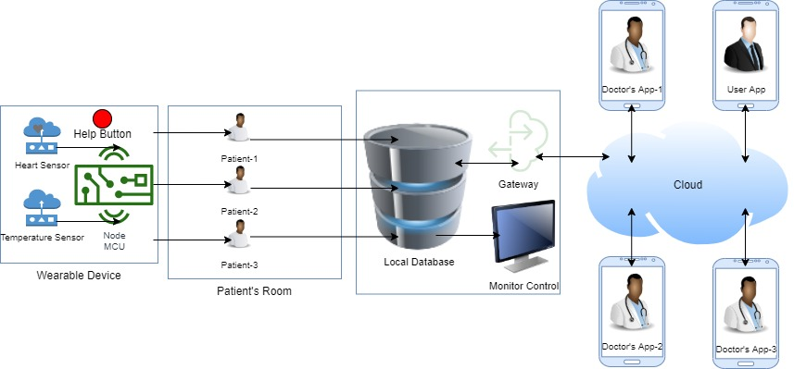
Methodology
United International University
Proposed System Architecture
Figure 2: Block Diagram of a system architecture
Figure 2: System Architecture
Develop a device that is used to collect data from the patient body.
Sensors collect the data and send it to local server through microcontroller.
To specify the information of a patient, we will use a gateway.
Develop a web application.

Slide 11
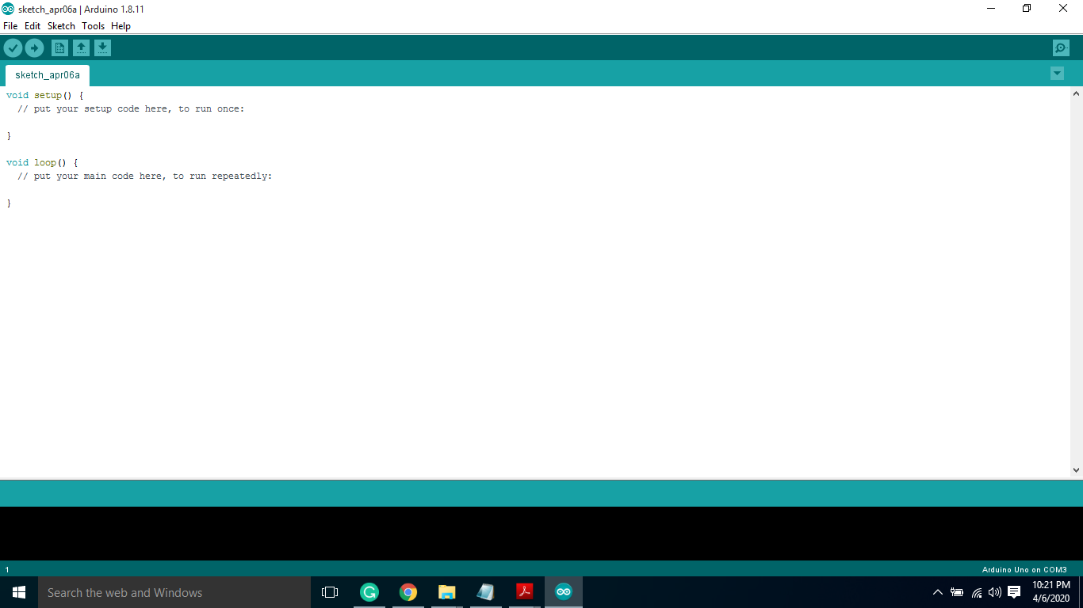

Methodology (contd.)
United International University
Software Requirements
Figure 3: Arduino IDE
Figure 4: Atom IDE
Open Source.
Support C and C++.
Open Source.
Support for plug-ins written in Node.js, python.

Slide 12
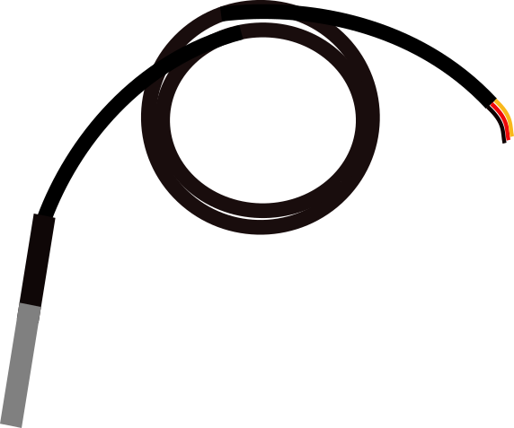
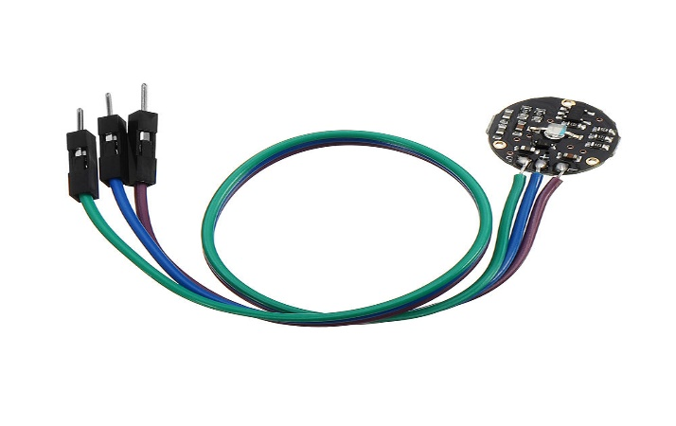
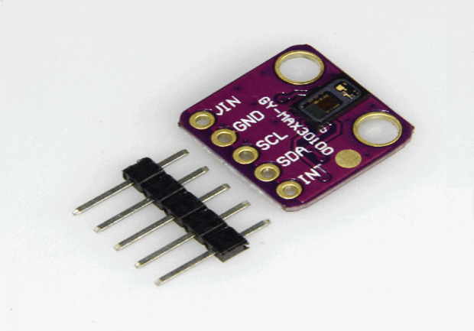
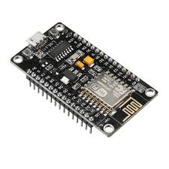
Methodology (contd.)
United International University
Hardware Requirements
Figure 5: Temperature Sensor
Figure 6: Pulse Sensor
Figure 8: Node MCU Microcontroller
Figure 7: Oximeter Sensor

Slide 13
Expected Outcome
United International University
Develop a monitoring system to observe the patient’s data in hospital.
Record the continuous evaluation of patient health condition.
Inform the assigned doctor & relatives automatically through a web application when a patient’s condition is unstable.

Slide 14
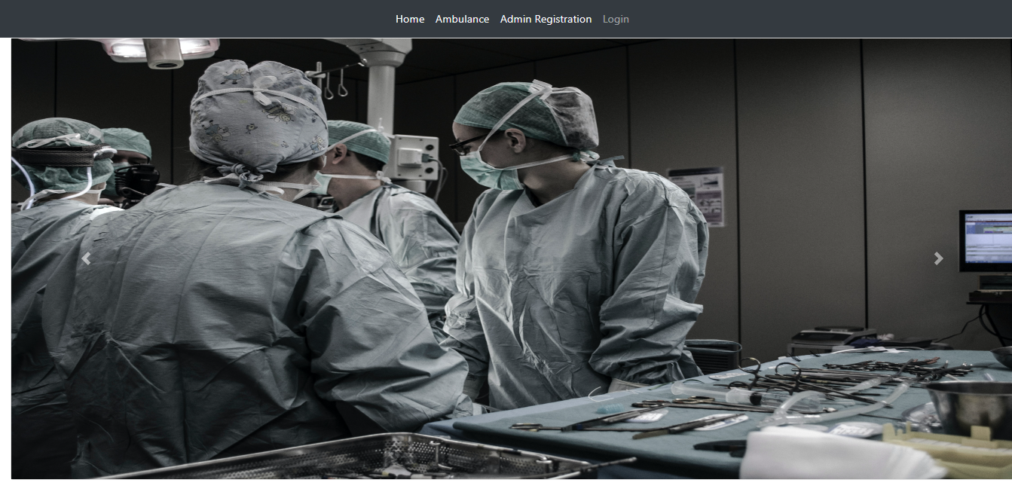
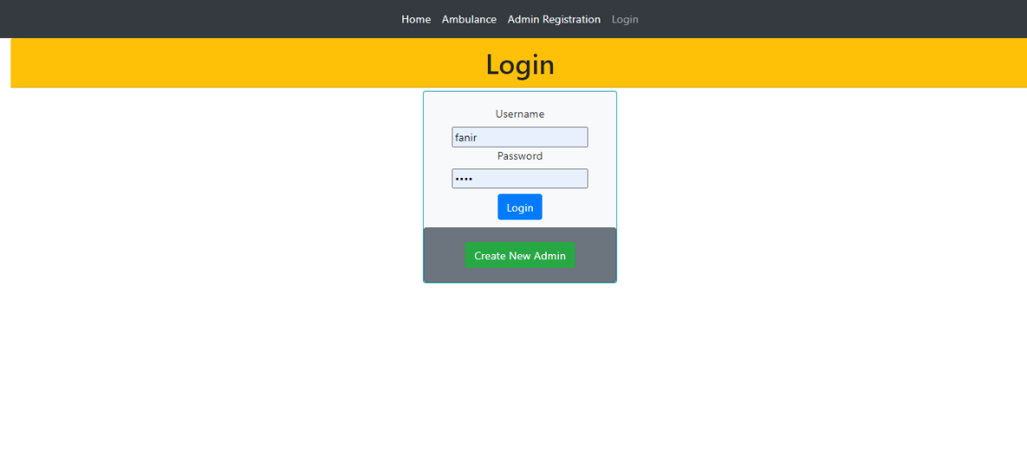
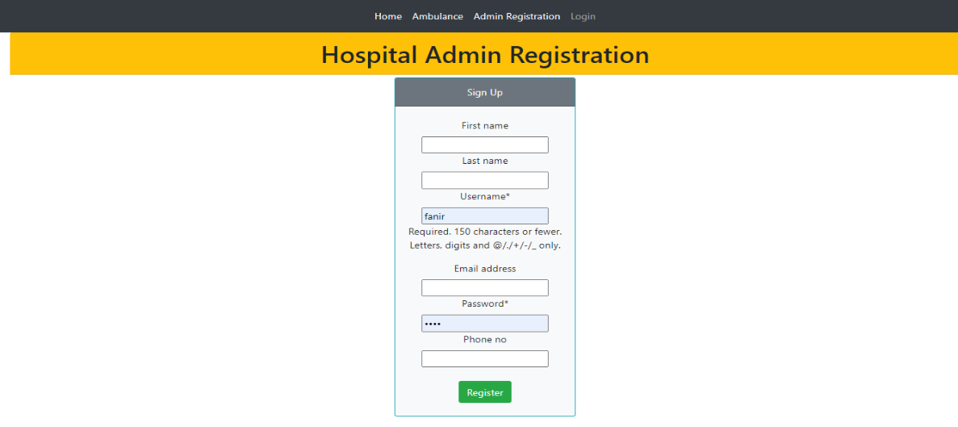
Implementation
United International University
Pictures of our System
Figure 9: Login Credential

Slide 15
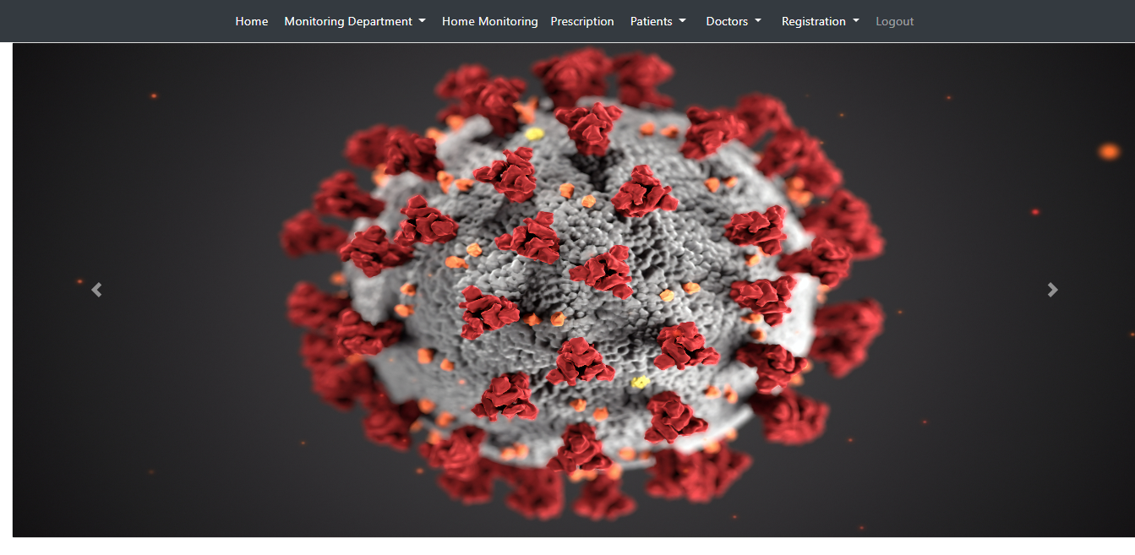
Implementation (contd.)
United International University
Pictures of our System
Cardiology Emergency Monitoring
Doctor Registration
Neurology Emergency Monitoring
Patient Registration
Gynecology Emergency Monitoring
Ambulance Registration
Orthopedics Emergency Monitoring
Cardiology
Neurology
Gynecology
Orthopedics
Figure 10: Home Page

Slide 16
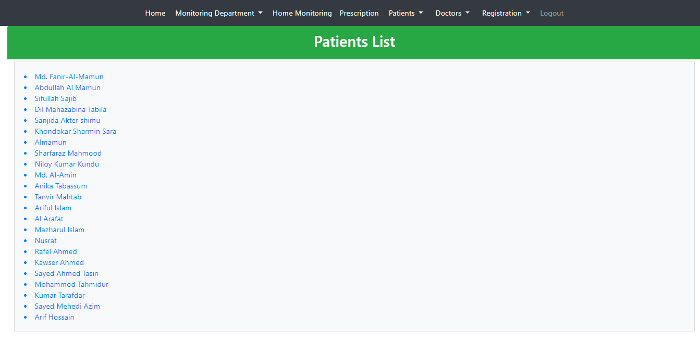
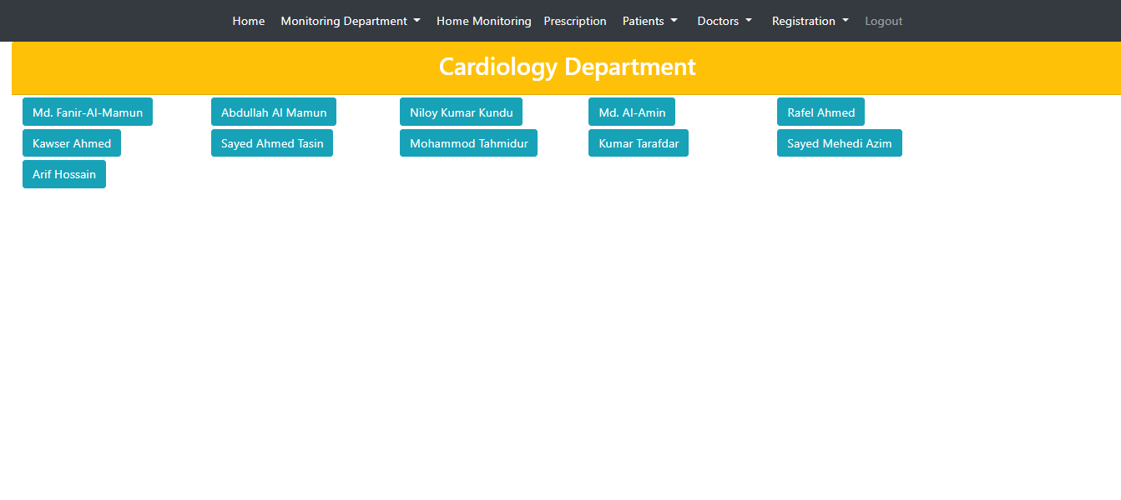
Implementation (contd.)
United International University
Pictures of our System
Figure 11: Patient List
Figure 12: Individual Department

Slide 17
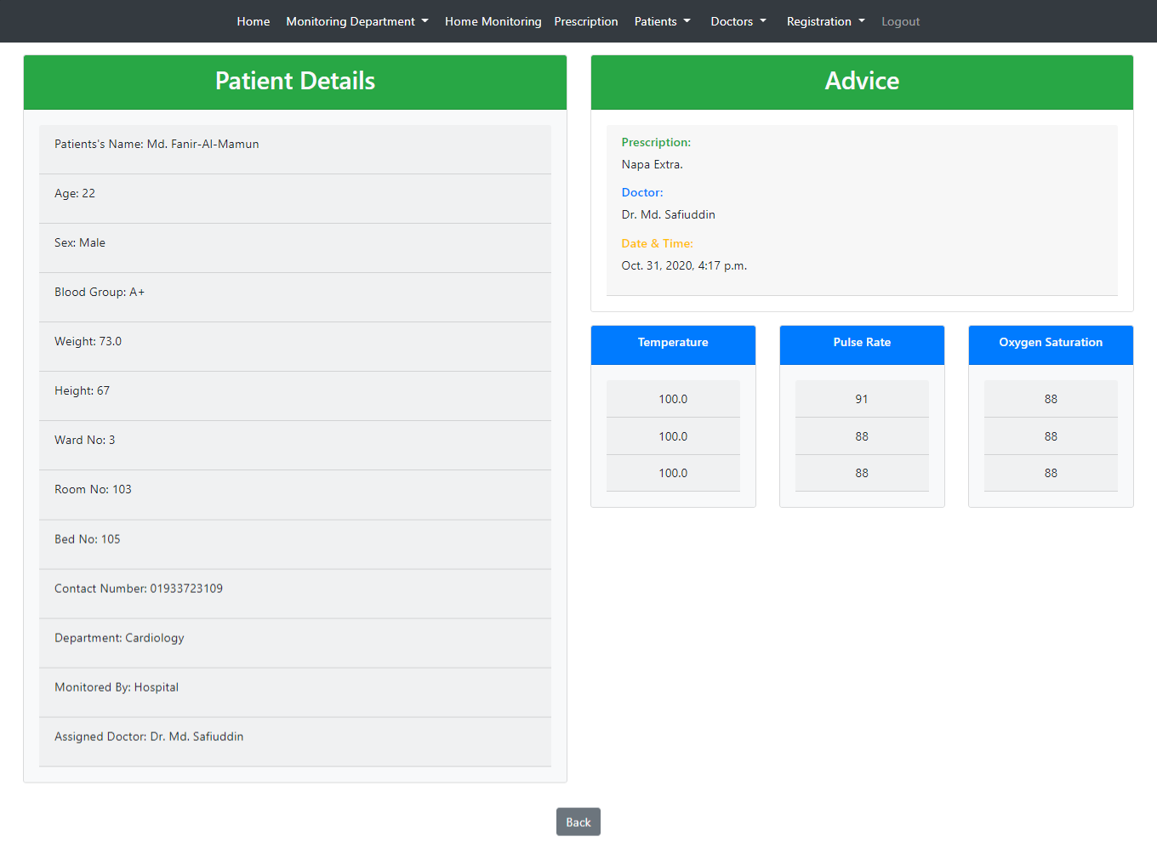
Implementation (contd.)
United International University
Pictures of our System
Figure 13: Patient Details

Slide 18
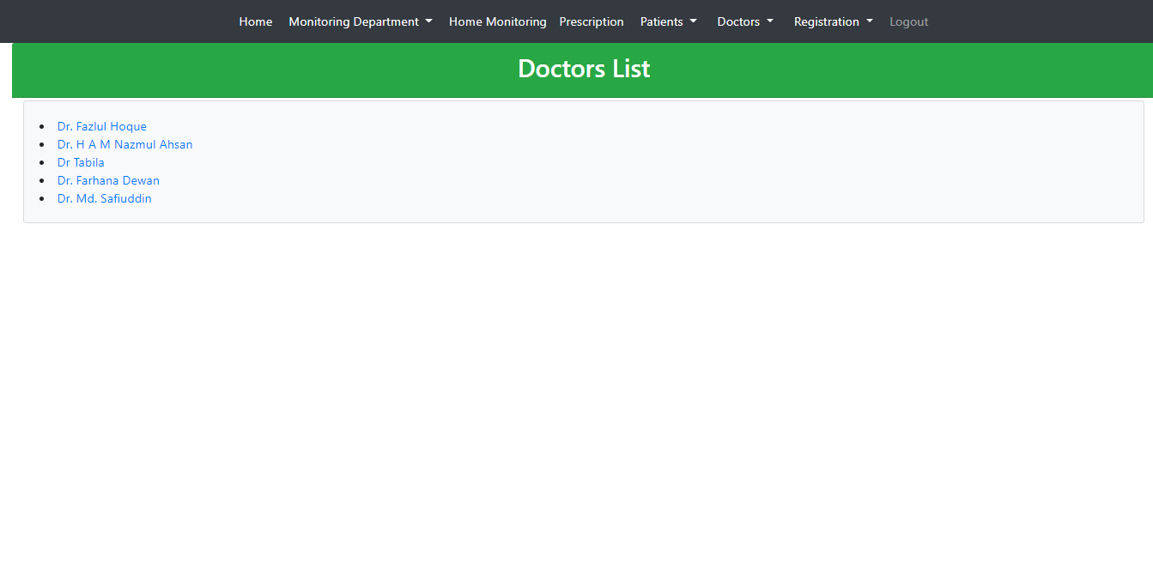
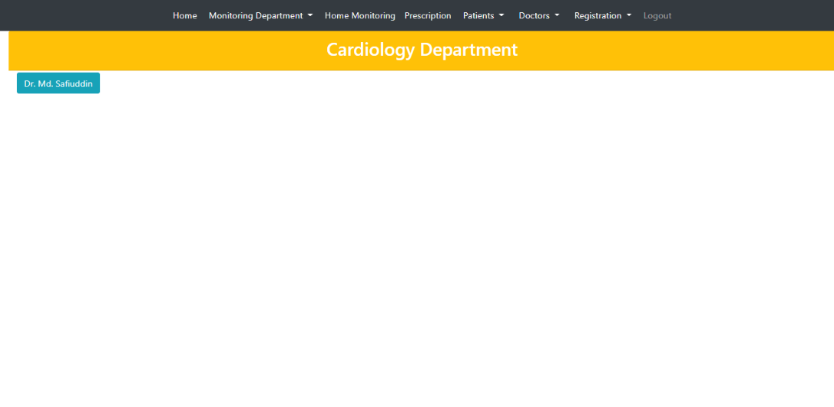
Implementation (contd.)
United International University
Pictures of our System
Figure 14: Doctor List
Figure 15: Individual Department

Slide 19
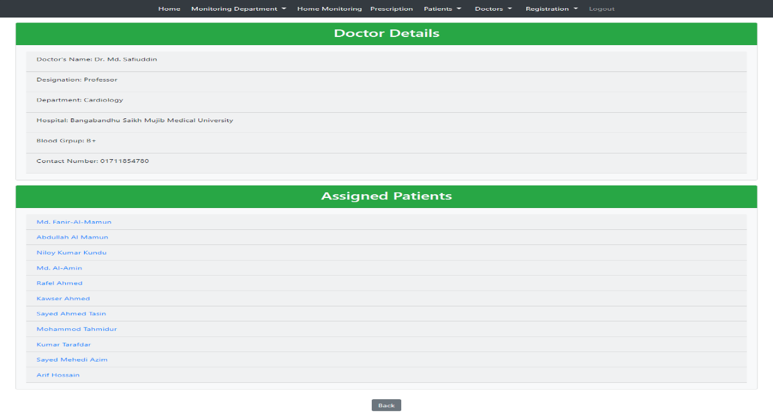
Implementation (contd.)
United International University
Pictures of our System
Figure 16: Doctor Details

Slide 20
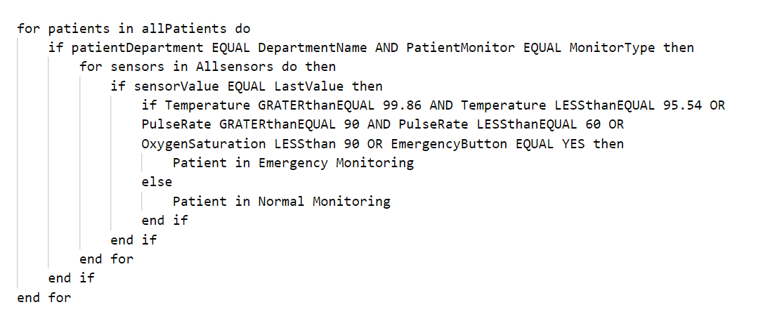
Implementation (contd.)
United International University
Pictures of our System
Figure 17: Algorithm for Emergency Monitoring

Slide 21
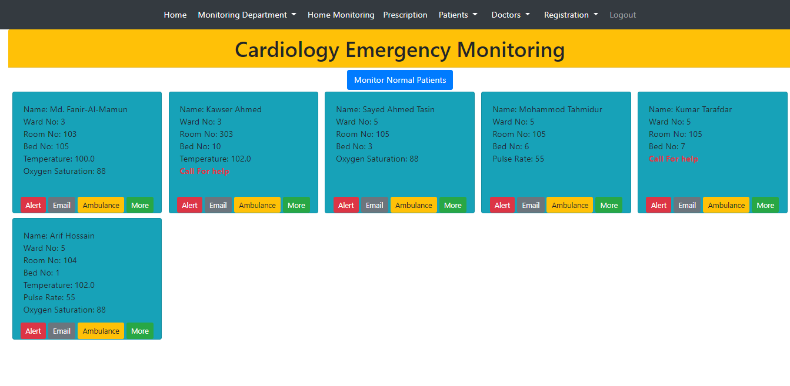
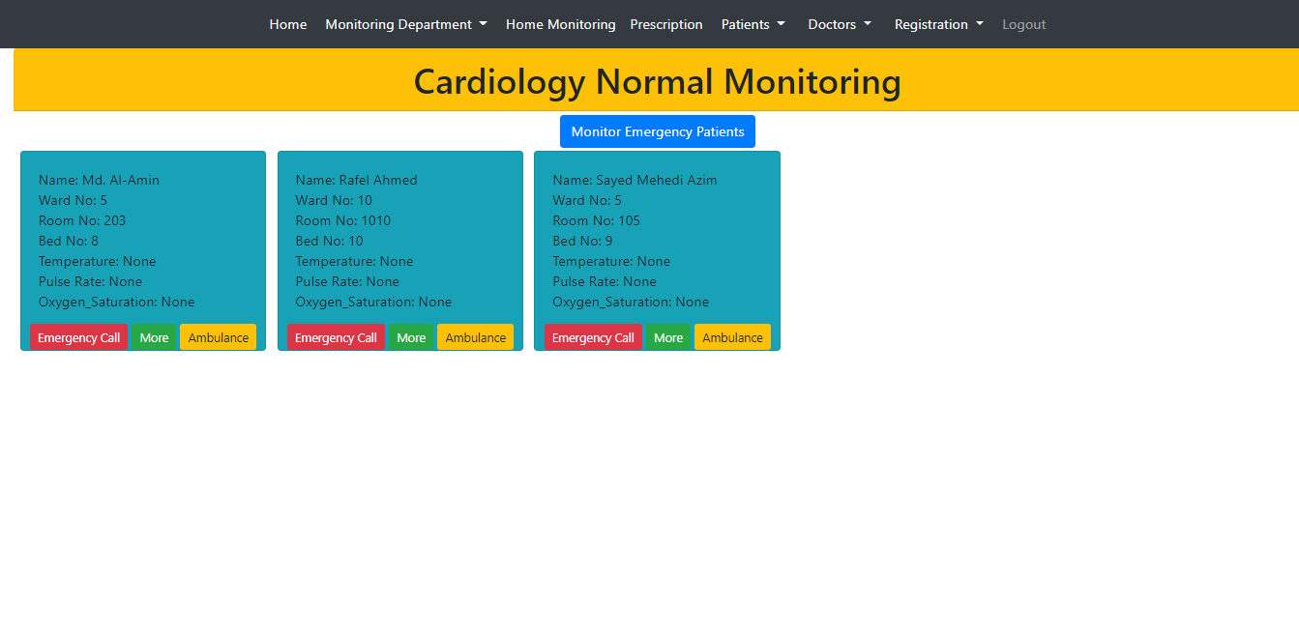
Implementation (contd.)
United International University
Pictures of our System
Figure 18: Emergency Monitoring
Figure 19: Normal Monitoring

Slide 22
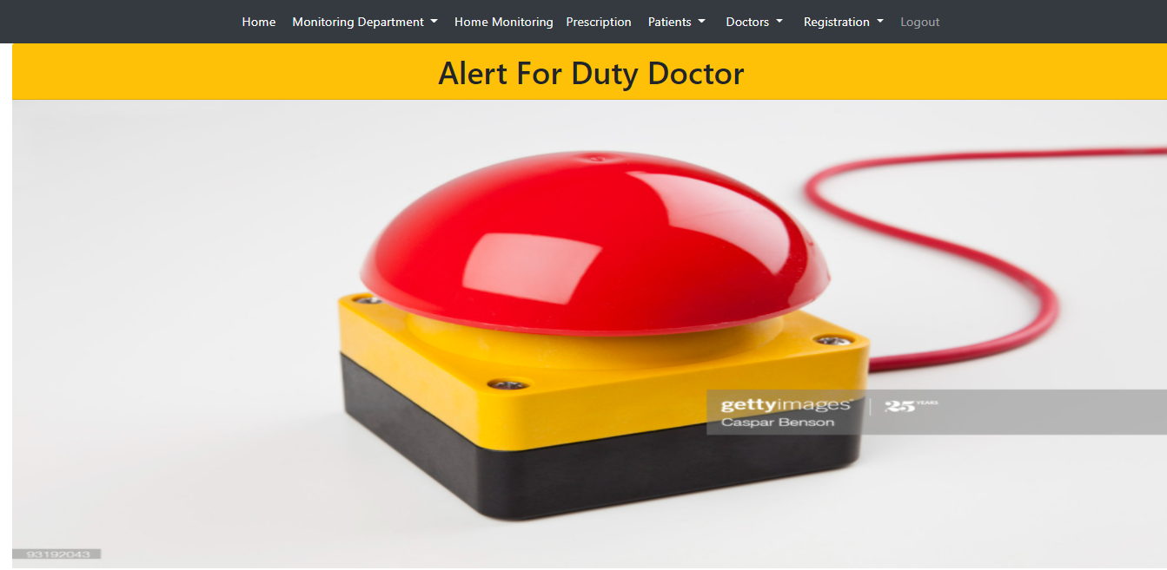
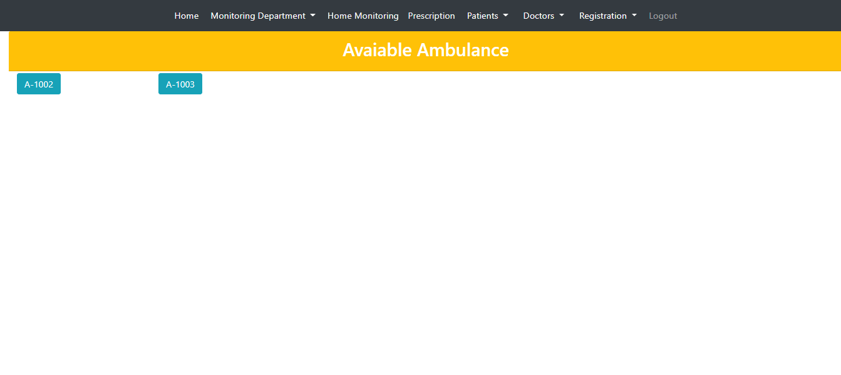
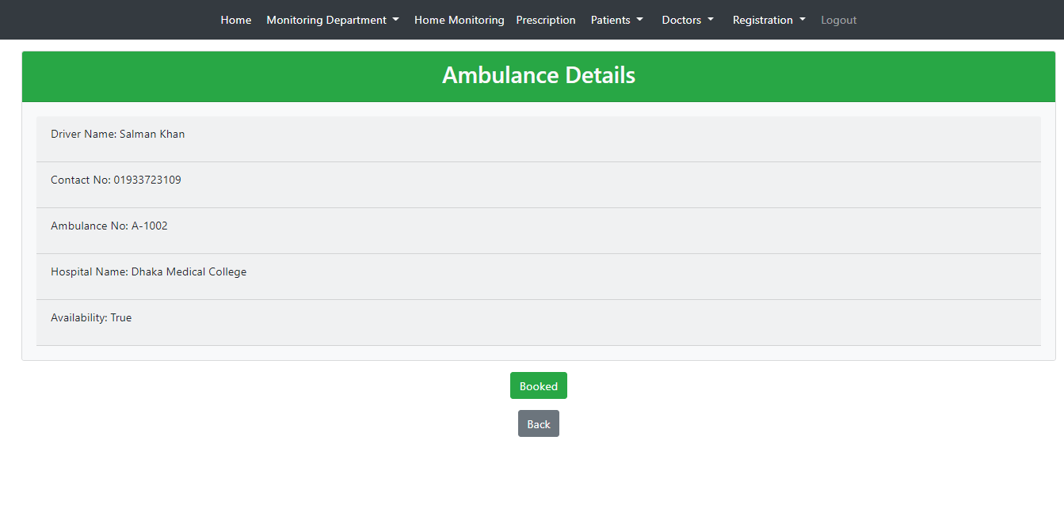
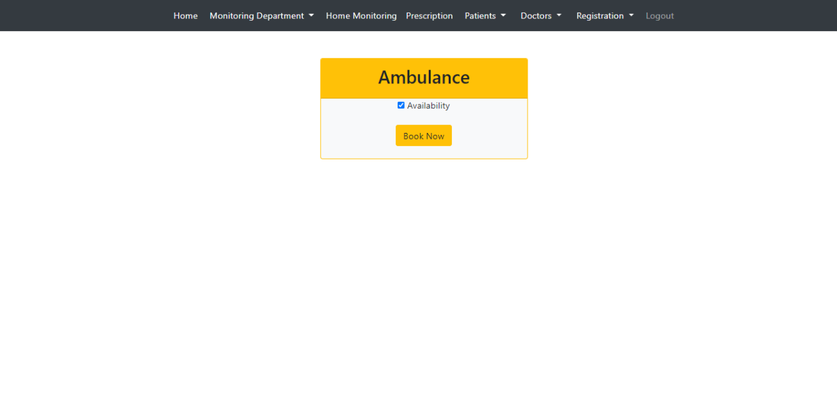
Implementation (contd.)
United International University
Pictures of our System
Figure 20: Emergency Alert
Figure 21: Available Ambulance
Figure 22: Ambulance Details
Figure 23: Ambulance Booking

Slide 23
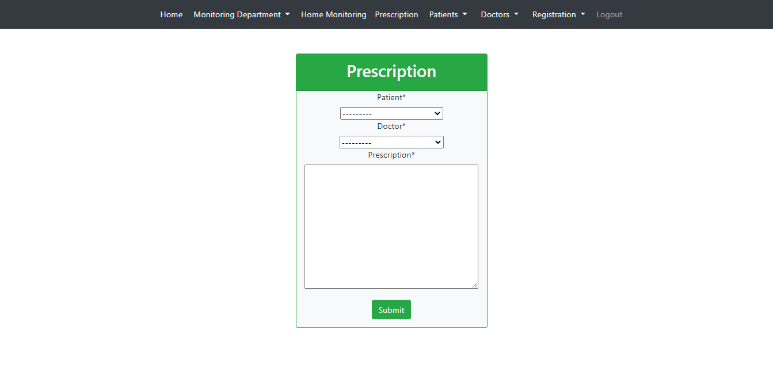
Implementation (contd.)
United International University
Pictures of our System
Figure 24: Doctor’s Prescription

Slide 24
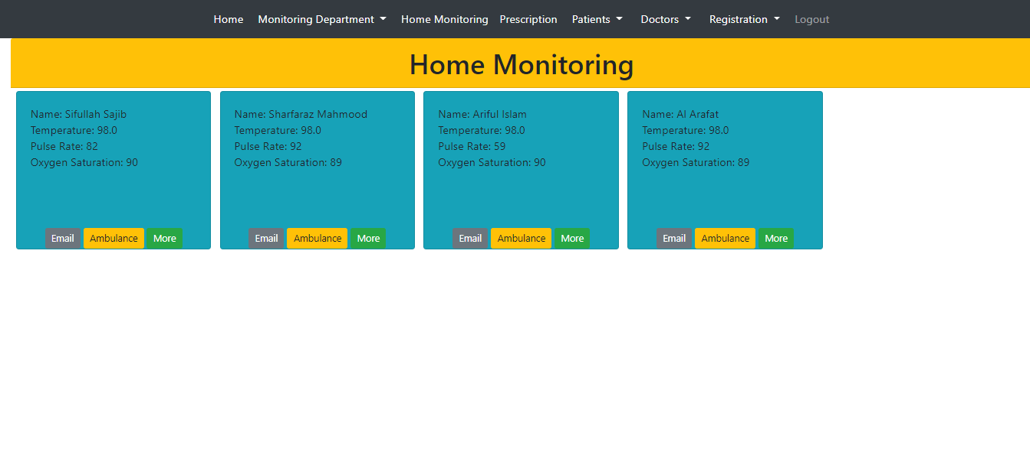
Implementation (contd.)
United International University
Pictures of our System
Figure 25: Home Monitoring

Slide 25
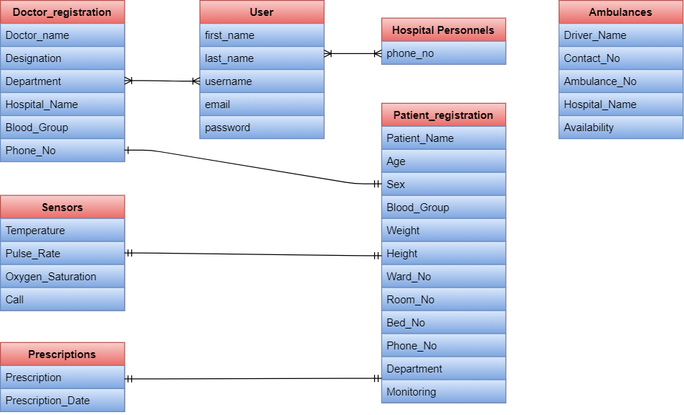
Implementation (contd.)
United International University
Pictures of our Database
Figure 26: Entity Relationship Diagram

Slide 26
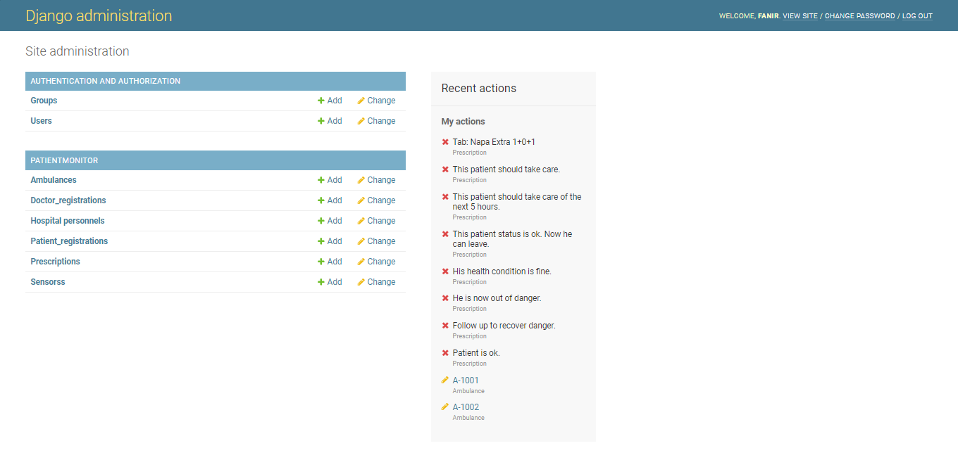
Implementation (contd.)
United International University
Pictures of our Database
Figure 27: Django Administration

Slide 27
Standards and Design Constraints
United International University
Standards:
Software Standard
The Linux Standard Based(LSB).
International Organization for Standardization(ISO).
Hardware Standard
IEEE 1451.
Communication Standard
IEEE 802.11.
Programming Language
Python, C, C++.
Constraints:
Sustainability.
Manufacturability.
Impacts:
Environmental Impacts.
Social Impacts.
Ethical Impacts.
Political Impacts.

Slide 28
Plan - Trimester 1
Gantt Chart
United International University
Problem Selection and Group Discussion
Literature Review
Presentation & Latex Overview
Report Writting
Week
1-2
Week 4-6
Week
8-9
Week
11
Week
3
Week
7
Week
10
Week
12
Problem Specification
Mid Week
Defining Methodology
Prepare for Pre-defence

Slide 29
Plan - Trimester 2
Gantt Chart (contd.)
United International University
Hardware and Software Design
Implementation -
Software
Testing
Final Report
Week
1-2
Week
5-6
Week
8
Week
11
Week
3-4
Week
7
Week
9-10
Week
12
Implementation -
Hardware
Mid Week
Result Analysis and Finalization
Prepare
for Defence

Slide 30
Conclusion and Future Work
United International University
Improve the monitoring of the patient’s health condition.
Fast and real-time tracking using IoT application for improved healthcare system .
In future, we will improve our project by using more advanced sensors and add more features.
Develop a mobile application.
Use machine learning application.
Improve our system with hospital requirements.

Slide 31
References
United International University
[1] Chao Li, Xiangpei Hu, and Lili Zhang. The iot-based heart disease monitoring system for pervasive healthcare service. Procedia computer science, 112:2328-2334, 2017.
[2] S Gowrishankar, MY Prachita, and Arvind Prakash. Iot based heart attack detection, heart rate and temperature monitor. International Journal of Computer Applications, 170(5):26-30, 2017.
[3] Vikas Vippalapalli and Snigdha Ananthula. Internet of things (iot) based smart health care system. In 2016 International Conference on Signal Processing, Communication, Power and Embedded System (SCOPES), pages 1229-1233. IEEE, 2016.
[4] JV Alamelu and A Mythili. Design of iot based generic health care system. In 2017 International conference on Microelectronic Devices, Circuits and Systems (ICMDCS), pages 1-4. IEEE, 2017.
[5] Anirvin Sharma, Tanupriya Choudhury, and Praveen Kumar. Health monitoring & management using iot devices in a cloud based framework. In 2018 International Conference on Advances in Computing and Communication Engineering (ICACCE), pages 219-224. IEEE, 2018.
[6] Naina Gupta, Hera Saeed, Sanjana Jha, Manisha Chahande, and Sujata Pandey. Study and implementation of iot based smart healthcare system. In 2017 International Conference on Trends in Electronics and Informatics (ICEI), pages 541-546. IEEE, 2017.
[7] Ravi Kishore Kodali, Govinda Swamy, and Boppana Lakshmi. An implementation of iot for healthcare. In 2015 IEEE Recent Advances in Intelligent Computational Systems (RAICS), pages 411-416. IEEE, 2015.
[8] R Kumar and M Pallikonda Rajasekaran. An iot based patient monitoring system using raspberry pi. In 2016 International Conference on Computing Technologies and Intelligent Data Engineering (ICCTIDE'16), pages 1-4. IEEE, 2016.
[9] K Natarajan, B Prasath, and P Kokila. Smart health care system using internet of things. Journal of Network Communications and Emerging Technologies (JNCET), 6(3), 2016.
[10] Zankhana Mehul Kalarthi. A review paper on smart health care system using internet of things. International Journal of Research in Engineering and Technology, 5(03):8084, 2016.
[11] P Elanthiraiyan, Dr S Babu, et al. Smart medicine and physical health system using Iot. International Journal of Computer Science and Mobile Computing, 4(3):333-338, 2015.
[12] Mirjana Maksimovic, Vladimir Vujovic, and Branko Perisic. A custom internet of things healthcare system. In 2015 10th Iberian Conference on Information Systemsand Technologies (CISTI), pages 1-6. IEEE, 2015.

Slide 32
References
United International University
[13] Musaed Alhussein, Ghulam Muhammad, M Shamim Hossain, and Syed Umar Amin. Cognitive iot-cloud integration for smart healthcare: case study for epileptic seizure detection and monitoring. Mobile Networks and Applications, 23(6):1624{1635, 2018.
[14] M Shamim Hossain, Ghulam Muhammad, and Atif Alamri. Smart healthcare monitoring: A voice pathology detection paradigm for smart cities. Multimedia Systems, 25(5):565{575, 2019.
[15] Abdul Ahad, Mohammad Tahir, and Kok-Lim Alvin Yau. 5g-based smart healthcare network: architecture, taxonomy, challenges and future research directions. IEEE Access, 7:100747{100762, 2019.
[16] Amir-Mohammad Rahmani, Nanda Kumar Thanigaivelan, Tuan Nguyen Gia, Jose Granados, Behailu Negash, Pasi Liljeberg, and Hannu Tenhunen. Smart e-health gateway: Bringing intelligence to internet-of-things based ubiquitous healthcare systems.
In 2015 12th Annual IEEE Consumer Communications and Networking Conference (CCNC), pages 826{834. IEEE, 2015.
[17] Md Golam Rabiul Alam, Md Shirajum Munir, Md Zia Uddin, Mohammed Shamsul Alam, Tri Nguyen Dang, and Choong Seon Hong. Edge-of-things computing framework for cost-eective provisioning of healthcare data. Journal of Parallel and
Distributed Computing, 123:54{60, 2019.
[18] Sukhpal Singh Gill, Rajesh Chand Arya, Gurpreet Singh Wander, and Rajkumar Buyya. Fog-based smart healthcare as a big data and cloud service for heart patients using iot. In International Conference on Intelligent Data Communication Technologies and Internet of Things, pages 1376{1383. Springer, 2018.
[19] Prabal Verma and Sandeep K Sood. Fog assisted-iot enabled patient health monitoring in smart homes. IEEE Internet of Things Journal, 5(3):1789{1796, 2018.
[20] Ziad Obermeyer, Jasmeet K Samra, and Sendhil Mullainathan. Individual dierences in normal body temperature: longitudinal big data analysis of patient records. Bmj, 359, 2017.
[21] Colin Hester. Celsius to fahrenheit|quick and dirty. Journal of Chemical Education, 72(11):1026, 1995.
[22] Robert Avram, Georey H Tison, Kirstin Aschbacher, Peter Kuhar, Eric Vittingho, Michael Butzner, Ryan Runge, Nancy Wu, Mark J Pletcher, Gregory M Marcus, et al. Real-world heart rate norms in the health eheart study. NPJ digital medicine,
2(1):1{10, 2019.
[23] Gozde Ates and Kemal Polat. Measuring of oxygen saturation using pulse oximeter based on fuzzy logic. In 2012 IEEE International Symposium on Medical Measurements and Applications Proceedings, pages 1{6. IEEE, 2012.

Slide 33

United International University

